Slide 1
Universal Plus
G12 Consultancy Services Presentation
Group 12
December 2022

Slide 2

CONTENTS
Industry Overview 3
Current Emailing System 5
Key Managerial Insights 7
Overview of CRISP-DM Methodology 12
Our Model 13
Saving Your Money 14
Why us 15
Suggestions for email templates & Other Factors 16
Roadmap 18

Slide 3
Universal Plus
Direct Email Marketing
Subscriber List
Strategy
Content
Reliability
Analysis
ROI

Slide 4
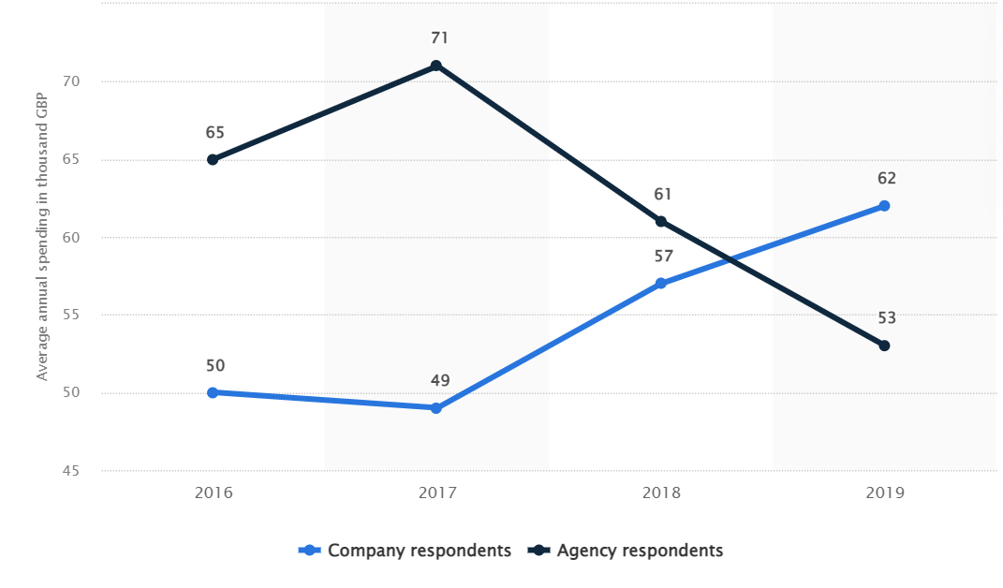
Industry Overview
(I) Average e-mail marketing spending at companies from 2016 to 2019

Slide 5
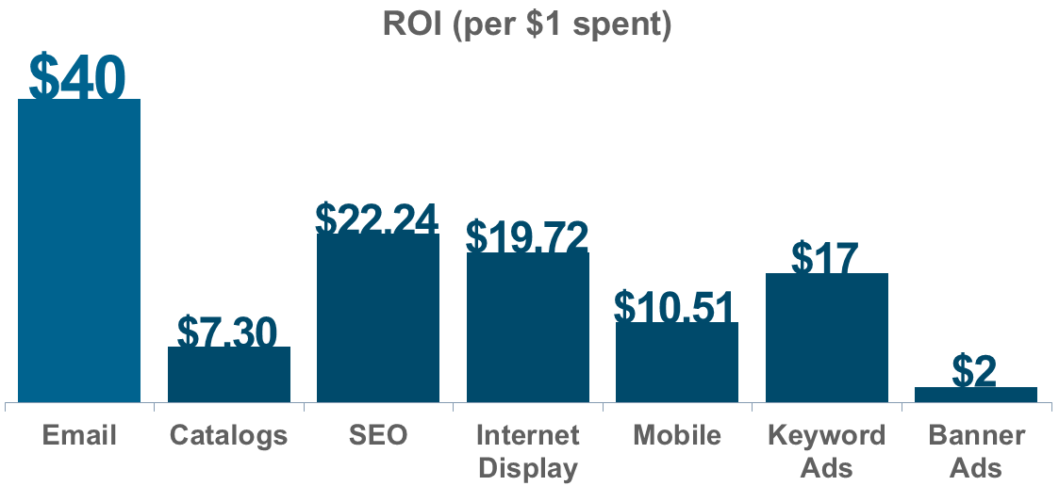
Industry Overview
(II) Return on Investment

Slide 6

Current Email System
Rule of Thumb. is a business valuation method that is based on common sense and experience.
Random Selection It attempts to achieve an unbiased representation of the total population.

Slide 7
Current Email System
(II) SWOT Analysis
S
Strengths
Weaknesses
W
Registered Customers
Detailed Data
Old Methodology
SWOT
Analysis
O
T
Opportunities
Threats
Ready Market
Target Audience
Cost
Data Storage

Slide 8
Key Insights Before Marketing Campaign
(I) Overall
Recency
Zip Area
Age Factor
Customer
Relationships
Other Insights
People in the suburban areas are more likely to visit the store
Most of the customers have purchased in the previous month before the campaign
People between the age 24-35 shop the most than compared to others.
Customers have doubled than the previous year
High number of customers are employed and have registered their phone
Credit Card
Channels
Most purchases are done using Phone and Web Services.
Most customers have registered their card details
Merchandise Segment
More purchases in segment 200-300 pounds, followed by 500-350 pounds segments
Purchase Segments
Men’s and Women’s Merchandise segments hold almost equal value in both count and sales.

Slide 9
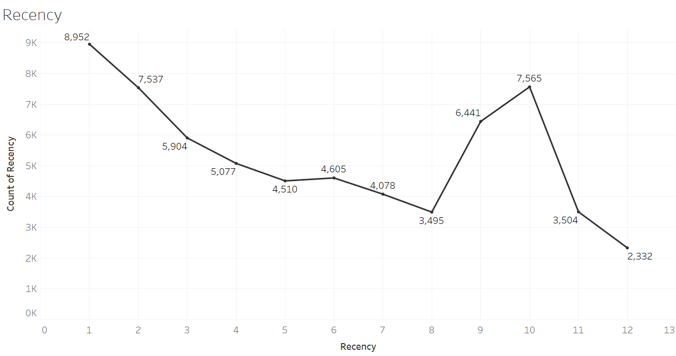
Key Insights Before Marketing Campaign
(II) By Recency
Most of the purchases are done in the previous month when compared to all other months of the year

Slide 10
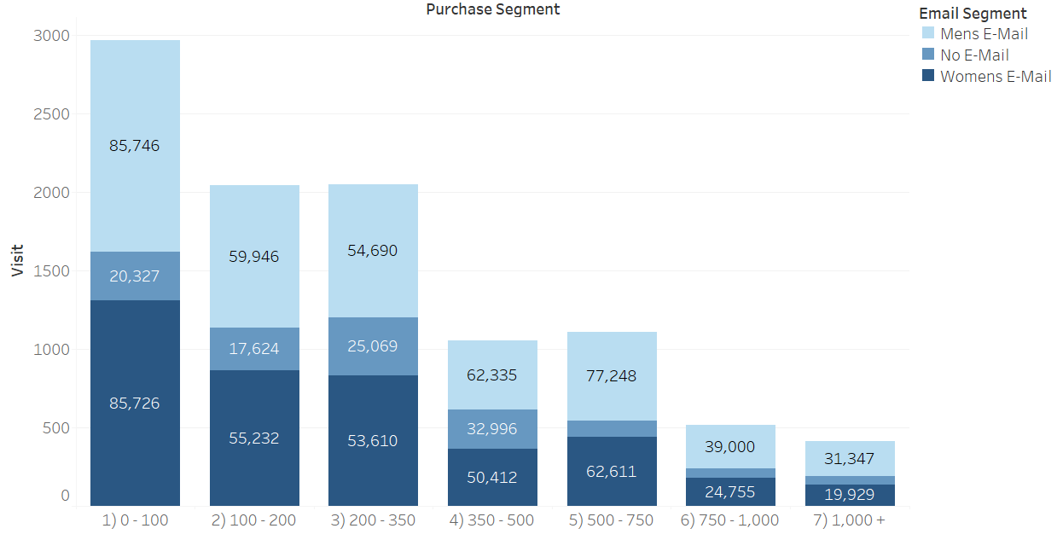
Key Insights Before Marketing Campaign
(III) By Men vs. Women
In the last two weeks, there have been a lot of spends and visits, and the graph shows the purchases based on email segments and emails sent in different purchase segments

Slide 11
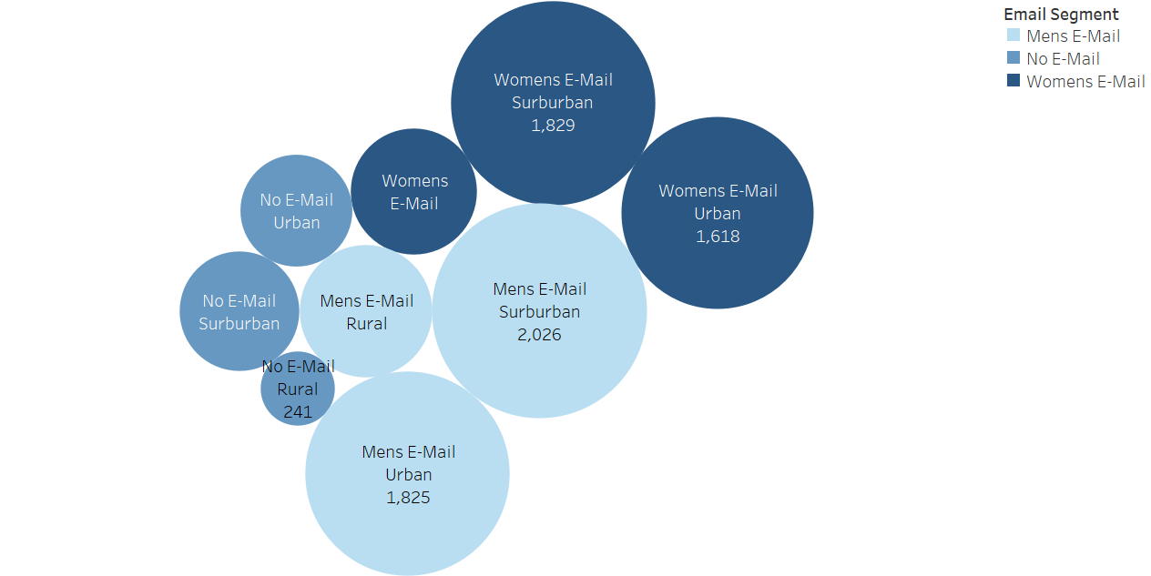
Key Insights Before Marketing Campaign
(IV) By Area
The graph depicts the number of visits made by men and women email segments in different areas over the last two weeks.

Slide 12
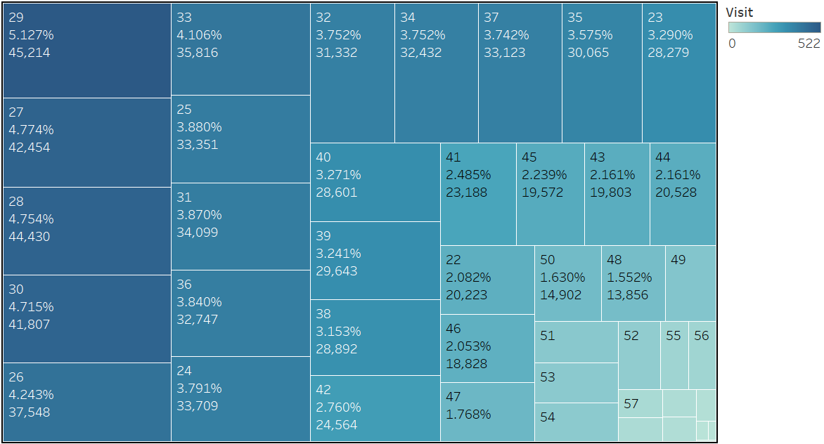
Key Insights Before Marketing Campaign
(V) By Age
The chart shows the percentage of visits made by each age group over the course of the previous two weeks as well as how much money they spent overall

Slide 13
Overview of CRISP-DM Methodology
1
2
3
4
5
6
Business Understanding
Data Understanding
Data Preparation
Modelling
Evaluation
Deployment
Business objective: Direct email campaign to target group of customers to make them visit the shop
Save on costs, increase sales
Understood the strengths and limitations
Explored the data and verified its quality
Transformed the data to be ready for modelling
Format and clean data
Selected 3 modelling techniques to predict customer visits
Generated test design
Assessed models to find best one
Assessed and evaluated the results in terms of business success criteria
Use evaluation results to determine a strategy for deployment

Slide 14
OUR MODEL – RANDOM FOREST
In simple words, Random Forest is a machine learning algorithm which learns to map data (e.g. temperature today) to outputs (temperature tomorrow) by learns any relationships between the data. Advantages include:
Ease of understanding
Higher accuracy
Large Datasets
The algorithm provides a higher level of accuracy in predicting target customers who will visit the shop compared to other models
It produces good predictions that can be understood easily.
It can handle large datasets efficiently
Model Name | Precision | Recall | Accuracy
Random Forest | 86.24% | 40.86% | 89.56%

Slide 15
SAVING YOUR MONEY
CURRENT EMAILS
Average Cost of one email: £0.12
Total cost: 0.12 * 42782 = £5134
GOAL WITH OUR MODEL
Precision of our model: 86.24%
Emails to be sent to achieve same number of visits: 8764 /0.8624 = 10,162
Total cost = 0.12 * 10162 = £1220
£3914
=
SAVINGS

Slide 16
WHY US?
What Universal Plus Need
What We Can Do
Direct email marketing system
Build a complete project
Identify which customers to target to visit the shops
Decrease costs, and increase sales
Create a tailor-made system
Target right customers: Predict customers with our model of 89.56% accuracy
Model leading to huge decrease in costs
Analysis of data and providing managerial insights
Show concrete and transparent results
Ongoing monitoring post deployment of system
Improve model consistently to drive profitability

Slide 17
Suggestions for email templates
Email subject should encompass a call-to-action
1
Subject
Details of the employee
Employee details makes the email personalized
Highlight benefits for recipient if they take the action
3
2
Details of the company
Benefits
Presence of a representative picture
4

Slide 18
Other Factors
5 Key Factors For Email Marketing Strategy Success.
Level 5
Level 4
Open rates and Click Through Rates
Level 3
A/B Testing
Level 2
Valuable Content
Level 1
Campaign Timing
Email retargeting

Slide 19
Roadmap
Data Collection
Data
Gather the needed information more particularly significant
Analyze and Act
Report
With the aid of a model, select the necessary audience for the desired material.
Cost Effective
Content
Market
Email Marketing
Valuable content
Increased sales by running an effective marketing campaign.
Targeted content and Valuable one to attract the customers

Slide 20
THANK YOU!

